Slide 1
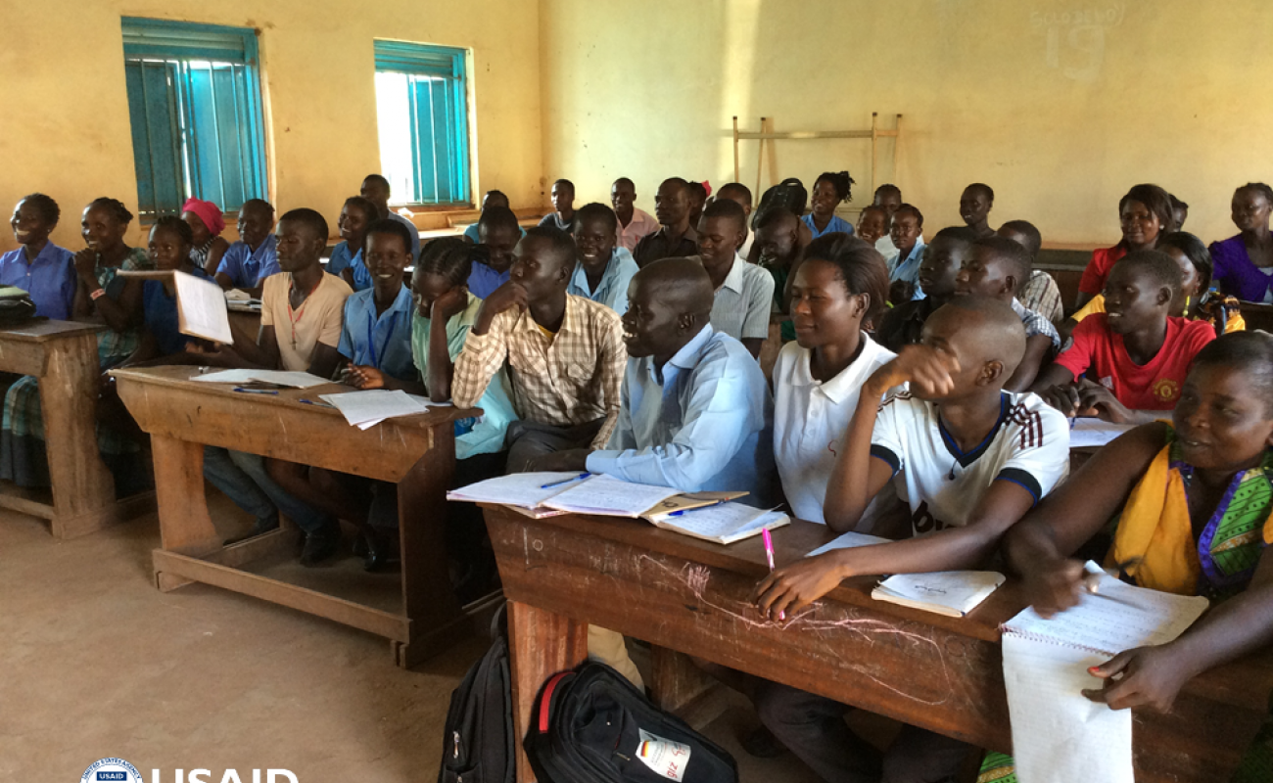
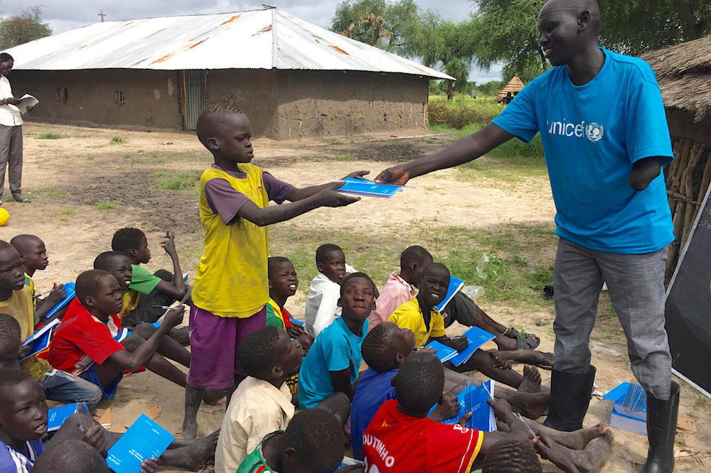
Education Census 2021

Slide 2
Coverage Overview

Slide 3
Number of closed and open schools by state
State | Open Schools | Closed Schools | Total Schools | % Clossed
Abyei Administrative Area | 36 | 3 | 39 | 8%
Central Equatoria | 995 | 207 | 1,202 | 17%
Eastern Equatoria | 432 | 113 | 545 | 21%
Jonglei | 314 | 54 | 368 | 15%
Lakes | 528 | 102 | 630 | 16%
Northern Bahr el Ghazal | 816 | 107 | 923 | 12%
Pibor Administrative Area | 112 | 28 | 140 | 20%
Ruweng Administrative Area | 117 | 25 | 142 | 18%
Unity | 212 | 131 | 343 | 38%
Upper Nile | 318 | 106 | 424 | 25%
Warrap | 984 | 265 | 1,249 | 21%
Western Bahr el Ghazal | 458 | 63 | 521 | 12%
Western Equatoria | 647 | 94 | 741 | 13%
Grand Total | 5,969 | 1,298 | 7,267 | 18%

Slide 4
Open schools by ownership
State | Community | Faith-based | NGO | Private | Public
Abyei Administrative Area | 0 | 3 | 0 | 2 | 31
Central Equatoria | 252 | 211 | 9 | 268 | 255
Eastern Equatoria | 120 | 81 | 2 | 44 | 185
Jonglei | 65 | 15 | 5 | 12 | 217
Lakes | 92 | 51 | 0 | 19 | 366
Northern Bahr el Ghazal | 88 | 53 | 0 | 46 | 629
Pibor Administrative Area | 26 | 6 | 3 | 10 | 67
Ruweng Administrative Area | 29 | 5 | 40 | 5 | 38
Unity | 37 | 10 | 5 | 2 | 158
Upper Nile | 52 | 40 | 67 | 30 | 129
Warrap | 281 | 48 | 1 | 12 | 642
Western Bahr el Ghazal | 138 | 71 | 2 | 70 | 177
Western Equatoria | 212 | 119 | 3 | 45 | 268
Grand Total | 1,392 | 713 | 137 | 565 | 3,162

Slide 5
Open schools by type of schooling
State | Boarding school | Day school | Mixed Day and Boarding
Abyei Administrative Area | 0 | 36 | 0
Central Equatoria | 9 | 969 | 17
Eastern Equatoria | 14 | 388 | 30
Jonglei | 2 | 294 | 18
Lakes | 3 | 517 | 8
Northern Bahr el Ghazal | 2 | 729 | 85
Pibor Administrative Area | 0 | 112 | 0
Ruweng Administrative Area | 0 | 116 | 1
Unity | 0 | 209 | 3
Upper Nile | 0 | 318 | 0
Warrap | 1 | 964 | 19
Western Bahr el Ghazal | 3 | 450 | 5
Western Equatoria | 5 | 639 | 3
Grand Total | 39 | 5,741 | 189

Slide 6
Open schools by Gender
State | Boys only | Girls only | Mixed school (Boys & Girls)
Abyei Administrative Area | 1 | 1 | 34
Central Equatoria | 6 | 7 | 982
Eastern Equatoria | 3 | 4 | 425
Jonglei | 0 | 3 | 311
Lakes | 7 | 21 | 500
Northern Bahr el Ghazal | 1 | 7 | 808
Pibor Administrative Area | 4 | 2 | 106
Ruweng Administrative Area | 1 | 1 | 115
Unity | 0 | 0 | 212
Upper Nile | 7 | 5 | 306
Warrap | 0 | 7 | 977
Western Bahr el Ghazal | 10 | 17 | 431
Western Equatoria | 0 | 4 | 643
Grand Total | 40 | 79 | 5,850

Slide 7
Schools with and without toilets
State | School with toilets | Schools where teacher share toilets with learners | Schools with no toilets
Abyei Administrative Area | 36 | 8 | 3
Central Equatoria | 995 | 210 | 207
Eastern Equatoria | 432 | 93 | 113
Jonglei | 329 | 91 | 54
Lakes | 528 | 118 | 102
Northern Bahr el Ghazal | 816 | 153 | 107
Pibor Administrative Area | 112 | 13 | 28
Ruweng Administrative Area | 117 | 20 | 25
Unity | 212 | 20 | 131
Upper Nile | 318 | 85 | 106
Warrap | 984 | 156 | 265
Western Bahr el Ghazal | 458 | 87 | 63
Western Equatoria | 647 | 154 | 94
Grand Total | 5,984 | 1,208 | 1,298

Slide 8
Open schools sharing compounds
State | Schools not sharing premise | Schools sharing premise | Percentage of schools sharing premise
Abyei Administrative Area | 27 | 9 | 25%
Central Equatoria | 852 | 143 | 14%
Eastern Equatoria | 320 | 112 | 26%
Jonglei | 234 | 95 | 29%
Lakes | 372 | 156 | 30%
Northern Bahr el Ghazal | 645 | 171 | 21%
Pibor Administrative Area | 99 | 13 | 12%
Ruweng Administrative Area | 92 | 25 | 21%
Unity | 140 | 72 | 34%
Upper Nile | 139 | 179 | 56%
Warrap | 724 | 260 | 26%
Western Bahr el Ghazal | 254 | 204 | 45%
Western Equatoria | 532 | 115 | 18%
Grand Total | 4,430 | 1,554 | 26%

